Slide 1



S225 HIT140
FOUNDATIONS OF DATA SCIENCE
Assessment 2:
Data Analyses

Slide 2

Team members
Darwin Group 38
Jay Wilson Malcampo (S387478)
Ngoc Loi Vong (S392159)
Axl Fortunato Espiritu (S387016)
Yi Fan Wu (388833)

Slide 3
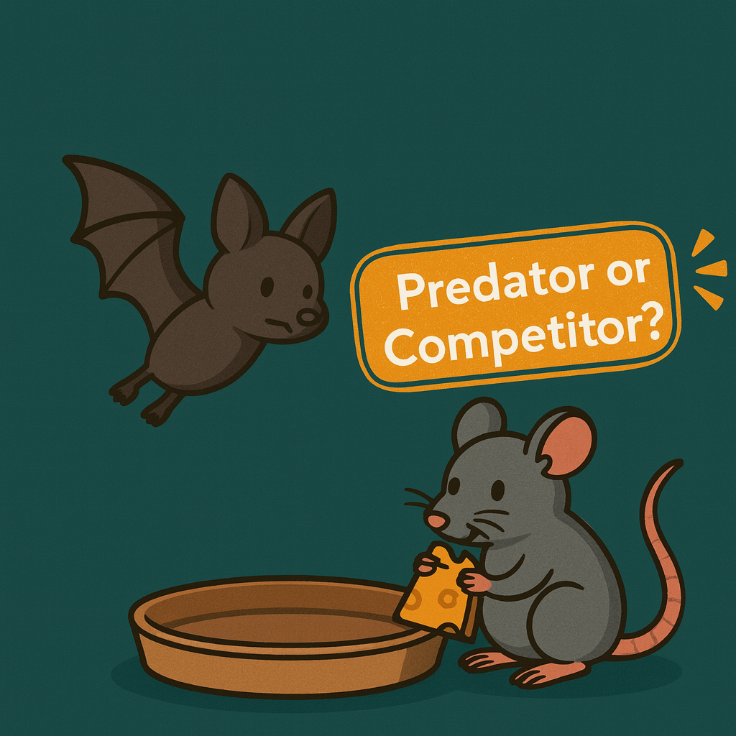
Do bats perceive rats not just as competitors for food but also as potential predators?
Title Axl Fortunato Espiritu (S387016)
Title Yi Fan Wu (388833)

Slide 4
Table Of Content
Background
Research & Hypotheses
Data Overview
Methodology
Approach
Descriptive Analysis &Inferential Analysis
Conclusion

Slide 5
Background
A group of zoologists investigated the foraging behaviour of Egyptian Fruit Bats (Rousettus aegyptiacus) in the presence of Black Rats (Rattus rattus). Over a 7-month period, they observed interactions between the two species at a provisioned food platform in a semi-natural, open bat colony. Surveillance video cameras were used to record the behaviours, and the resulting observations were organized into two datasets for analysis.
Do bats perceive rats not just as competitors for food but also as potential predators?
The purpose of this study is to examine whether bats perceive rats as competitors or potential predators by analysing hesitation time, landing frequency, and feeding success.

Slide 6

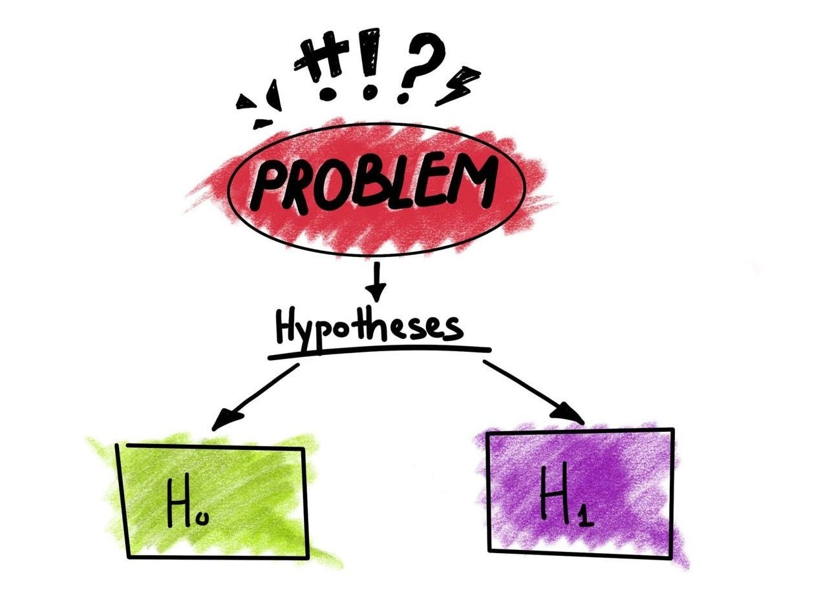
Research Question & Hypotheses
Hypotheses Framework
Hesitation Time
H0: Bat hesitation time is the same whether rats are present or not.
H1: Bat hesitation time is different when rats are present compared to when they are absent.
Bat Landings
H0: The number of bat landings is the same between rat-present and no-rat conditions.
H1: The number of bat landings is different between the two conditions.
Feeding Success
H0: Feeding success rate is the same whether rats are present or not.
H1: Feeding success rate is different depending on rat presence.

Slide 7

Data Overview
Dataset 1
Records each individual bat landing on the food platform.
Key variables: bat_landing_to_food, risk, reward, habit, rat_period_start/end, seconds_after_rat_arrival, hours_after_sunset.
Data type: observational behavioural data (categorical, numerical).
Dataset 2
Records 30-minute observation sessions.
Key variables: bat_landing_number, rat_arrival_number, hours_after_sunset.
Data type: aggregated quantitative data (continuous numerical).

Slide 8
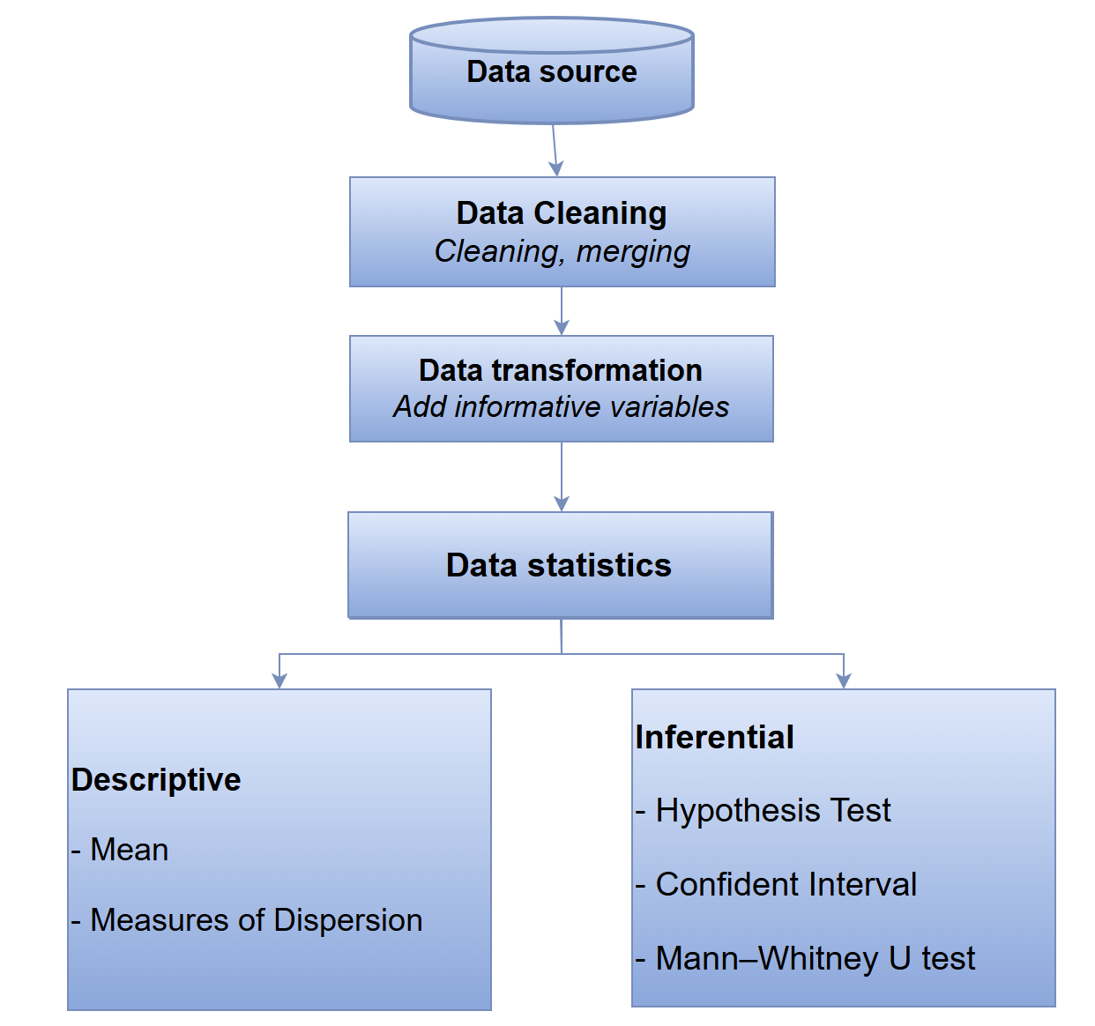
Methodology
Methodology
Data Cleaning
Convert datetime & numeric fields
Remove nulls, duplicates, outliers (>60s)
Drop noisy labels in habit
Data Transformation
Normalize hours_after_sunset (0.5h bins)
Merge dataset1 + dataset2 (date + time window)
Feature engineering: rat_present
Data Statistics Descriptive: mean, mode, std, IQR (dispersion)
Inferential: chi-square, Mann–Whitney U

Slide 9
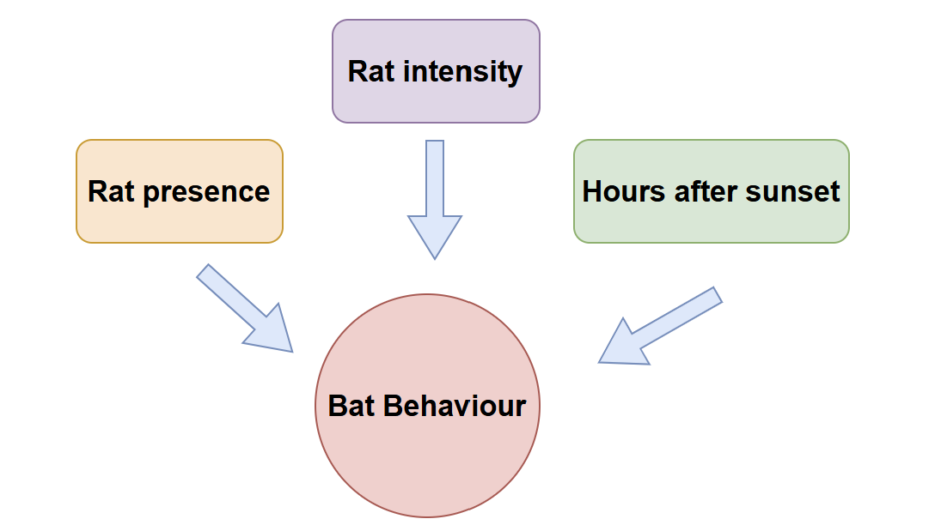
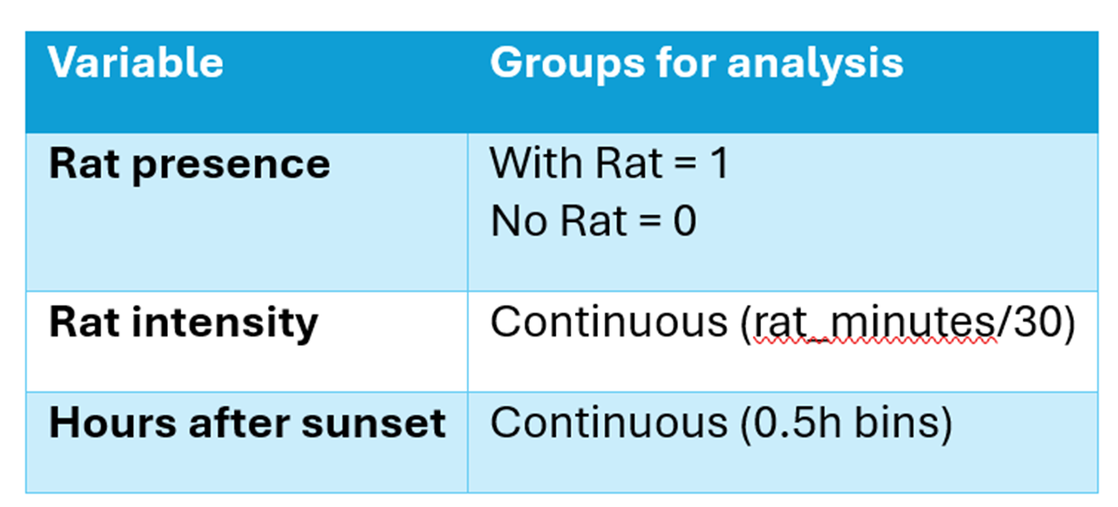
Approach
Any difference in bat behaviour between rat-present and no-rat groups?

Slide 10
Variables in the Dataset
date | habit | hours_after_sunset
risk | reward | bat_landing_to_food
food_availability | rat_arrival_number | bat_landing_number

Slide 11
Feature Engineering
Converting rat_arrival_number into nominal data:
If rat_arrival_number > 0
rat_present = 1
If rat_arrival_number = 0
rat_present = 0
With this we can determine instances of rat presence and monitor differences in bat behaviour and activity.

Slide 12
Descriptive Analysis
Hesitation Time by Rat Presence
Mean Bat Landing By Rat Presence
Landing Number Over Time By Rat Presence
Distribution of Bat Landing By Rat Presence
Feeding Success Rate By Rat Presence
Risk Taking Rate By Rat Presence

Slide 13
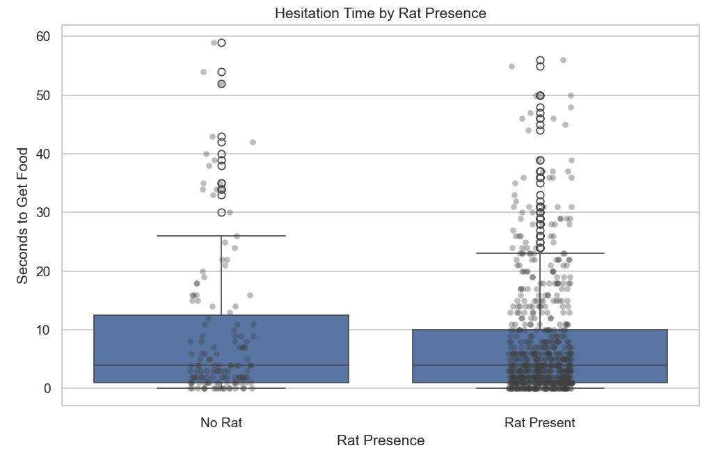
Hesitation Time by Rat Presence
No Rat:
Mean = 9.52, Median = 4.0,
Std = 12.7
With Rat :
Mean = 7.66, Median = 4.0, Std = 9.9

Slide 14
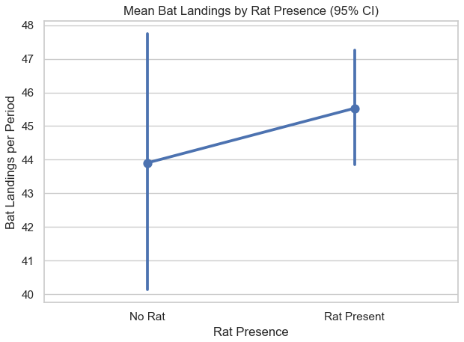
Mean Bat Landing By Rat Presence
No Rat:
Mean = 43.91 , Median = 42.5, Std = 21.4
With Rat :
Mean = 45.53, Median = 45.0, Std = 23.89

Slide 15
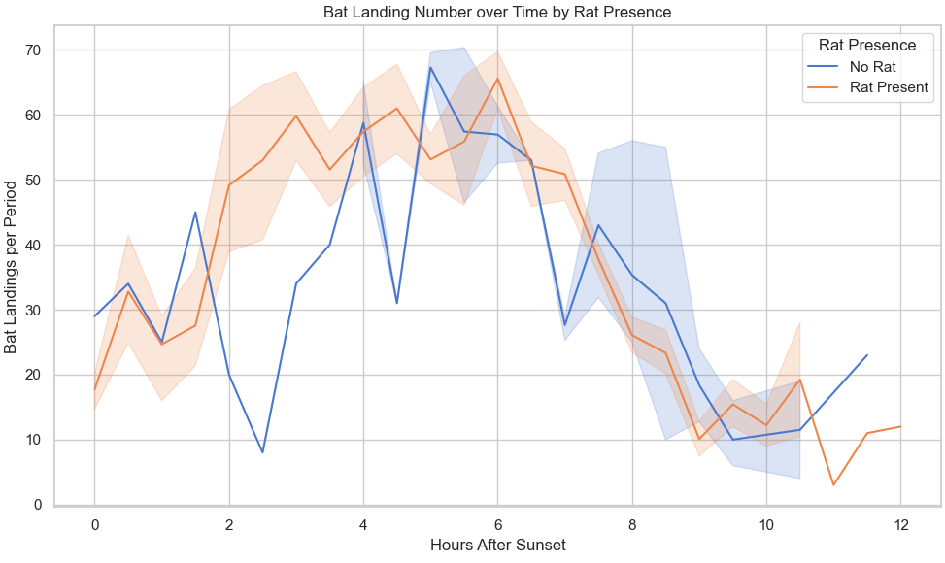
Landing Number Over Time By Rat Presence
Peak landings at 2–6 hrs after sunset
More landings when rats present
More stable with rats, more variable without

Slide 16
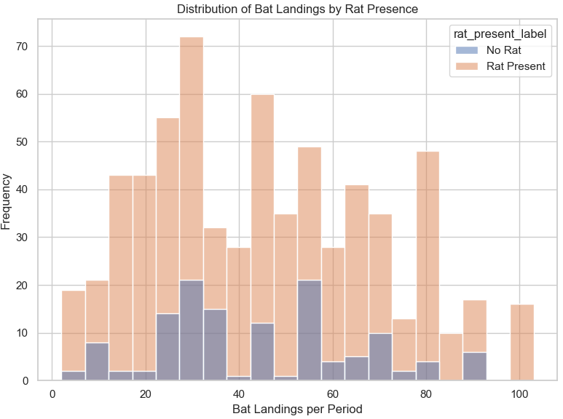
Distribution of Bat Landing By Rat Presence
More frequent landings with rats present
Wider distribution under rat presence
No rat cases cluster at lower landings

Slide 17
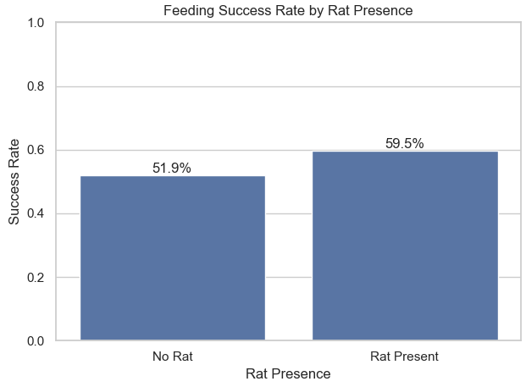
Feeding Success Rate By Rat Presence
No Rat: 51.9%
Rat Present: 59.5%
Higher success rate when rats present

Slide 18
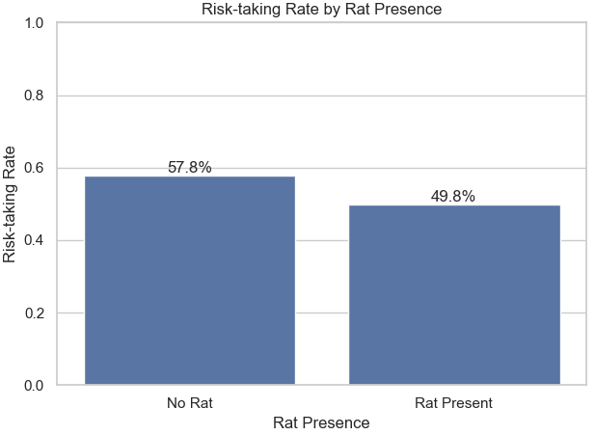
Risk Taking Rate By Rat Presence
No Rat: 57.8%
Rat Present: 49.8%
Lower risk-taking when rats present

Slide 19
Inferential Analysis
Objective: Test if bats see rats as just competitors or as predators and competitors
Descriptive and Inferential Analysis
Descriptive - shows patterns
Inferential - tests if patterns are real or just chance
Behaviors Tested:
Hesitation time
Bat landings
Feeding success
Risk-taking

Slide 20
Hypothesis Testing Framework
The 4-Step Hypothesis Testing Process
State
Null Hypothesis (H₀): Rat presence has no effect.
Alternative Hypothesis (H₁): Rat presence changes bat behavior.
Plan
Choose test depending on variable:
Hesitation, Landings → t-test
Feeding Success, Risk → Chi-square
Solve
Run tests in Python (scipy.stats).
Calculate p-values and effect sizes.
Conclude
If p < 0.05 → significant difference.
If p ≥ 0.05 → no significant effect.

Slide 21
Hesitation Time
Tested Variable: Bat hesitation time (seconds to approach food)
Hypotheses
H₀: No difference in hesitation with vs. without rats
H₁: Bats hesitate more when rats are present
Test Used:
Welch’s t-test (different group sizes, unequal variance)
Mann–Whitney U (non-parametric check)
Results:
t = 1.601, p = 0.111 → Not significant
U = 46850, p = 0.421 → Not significant
Cohen’s d = 0.178 → Small effect
Conclusion: Bats do not hesitate more when rats are present.
TEST | STATISTIC | p-VALUE | EFFECT SIZE | CONCLUSION
Welch’s t-Test | t = 1.601 | p = 0.111 | Cohen’s d = 0.178 | No significant difference
Mann–Whitney U | U = 46850 | p = 0.421 | - | Confirms no difference

Slide 22
Bat Landings
Tested Variable: Bat landing frequency (number of landings)
Hypotheses
H₀: Rat presence has no effect on bat landings
H₁: Rat presence reduces bat landings
Test Used:
Welch’s t-test (independent groups)
Results:
t = -0.776, p = 0.439 → Not significant
Cohen’s d = -0.069 → Negligible effect
Conclusion: Rat presence does not reduce bat landing frequency.
TEST | STATISTIC | p-VALUE | EFFECT SIZE | CONCLUSION
Welch’s t-Test | t = -0.776 | p = 0.439 | Cohen’s d = -0.069 | No significant difference

Slide 23
Feeding Success
Tested Variable: Feeding success (reward: success vs failure)
Hypotheses
H₀: Rat presence has no effect on feeding success
H₁: Rat presence reduces feeding success
Test Used:
Chi-square test of independence (categorical outcome)
Results:
χ² = 2.426, p = 0.119 → Not significant
Success rate: 52% (No Rat) vs 59% (Rat Present)
Cramér’s V = 0.055 → Very weak association
Conclusion: Rats do not reduce feeding success - bats still get food.
TEST | STATISTIC | p-VALUE | EFFECT SIZE | CONCLUSION
Chi-square | χ² = 2.426 | p = 0.119 | Cramér’s V = 0.055 | No significant association

Slide 24
Risk-Taking
Tested Variable: Risk-taking behavior (0 = avoidance, 1 = attack/confront rats)
Hypotheses
H₀: Rat presence has no effect on risk-taking behavior
H₁: Rat presence changes risk-taking behavior
Test Used:
Chi-square test of independence (categorical outcome)
Results:
χ² = 2.565, p = 0.1092
Risk-taking rate (No Rat) = 57.8%
Risk-taking rate (Rat Present) = 49.8%
Effect size: Cramér’s V = 0.057
Conclusion: No significant evidence that rats increase risk-taking.
TEST | STATISTIC | p-VALUE | EFFECT SIZE | CONCLUSION
Chi-square | χ² = 2.565 | p = 0.109 | Cramér’s V = 0.057 | No significant association

Slide 25
Conclusion
VARIABLE | TEST | STATISTIC | p-VALUE | EFFECT SIZE | CONCLUSION
Hesitation Time | Welch’s t-test; Mann–Whitney U | t = 1.601 U = 46850 | 0.111 0.421 | Cohen’s d = 0.178 | No significant difference
Bat Landings | Welch’s t-test | t = -0.776 | 0.439 | Cohen’s d = -0.069 | Not reduced
Feeding Success | Chi-square test | χ² = 2.426 | 0.119 | Cramér’s V = 0.055 | Not reduced
Risk-taking | Chi-square test | χ² = 2.565 | 0.109 | Cramér’s V = 0.057 | No significant change
Summary of Results
Hesitation Time → No significant difference
Bat Landings → No significant reduction
Feeding Success → Not significantly reduced
Risk-Taking → No significant change
Final Interpretation Rats are treated as competitors for food, not as predators.

